Slide 1
IOT Based
Advanced Home Automation
System
Ashikur Rahman (16201127)

Slide 2

Introduction
What is IOT ?
IOT is short for Internet of Things. The Internet of Things refers to the ever-growing network of physical objects that feature an IP address for internet connectivity, and the communication that occurs between these objects and other Internet-enabled devices and systems.
What is Smart Home?
“Smart Home” is the term commonly used to define home or building, equipped with special system that does some intelligent actuations according to situation. Integration of the home systems allows them to communicate with one another through the home controller in pre-programmed scenarios or operating modes.

Slide 3
What is Automation?
Automation is the process of automatically performing everyday functions around the home to save you time, energy, money and at the same time offering improved security.
IOT BASED SMART HOME AUTOMATION SYSTEM
With the help of IOT if we control hardware devices through the internet and we control our home appliances, thus automating modern homes through the internet. Then we called it as a IOT Based Smart Home Automation System.

Slide 4
Basic Components and Required Software
Hardware components:
1. Arduino UNO
2. NodeMCU
3. Relay Board
Software components:
1. Google Assistant
System
2. Arduino IDE
3. Adafruit IO
4. Chatfuel
5. IFTTT
6. Blynk

Slide 5
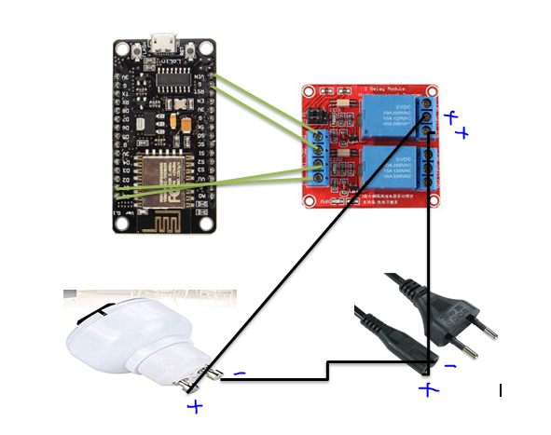
Circuit Diagram

Slide 6
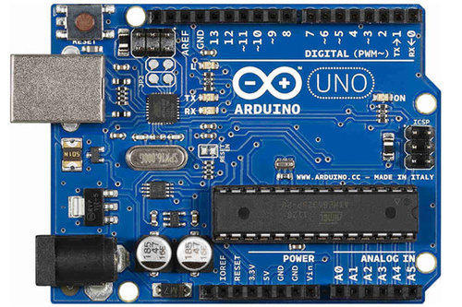
Arduino Uno
The Arduino Uno is a microcontroller board based on the ATmega328 (datasheet). It has 14 digital input/output pins (of which 6 can be used as PWM outputs), 6 analog inputs, a 16 MHz ceramic resonator, a USB connection, a power jack, an ICSP header, and a reset button.
And we used this feature to make our System.
Arduino board is an open-source platform used to make electronics projects.
Fig: Aurduino Uno

Slide 7
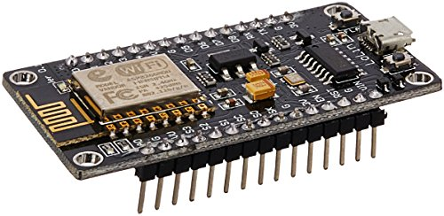
NodeMCU
NodeMCU is an open source IoT platform. ENodeMCU is a development board featuring the popular ESP8266 WiFi chip. As it turns out, we programed the ESP8266 just like any other microcontroller. Its obvious advantage over the Arduino or PIC is that it can readily connect to the Internet via WiFi. We used it to make the whole process wireless.
Fig: NodeMCU

Slide 8
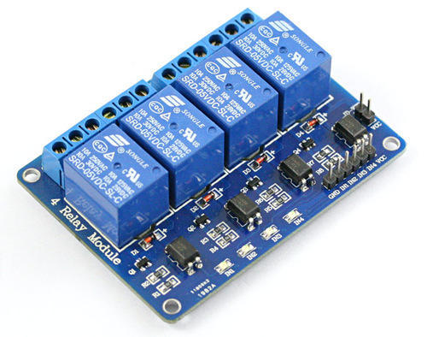
Relay Board
A relay is an electrically operated switch. Relays we used where it is necessary to control a circuit by a separate low-power signal, or where several circuits must be controlled by one signal. We also used to control power circuits with no moving parts, instead using a semiconductor device to perform switching.
Fig: Relay Board

Slide 9
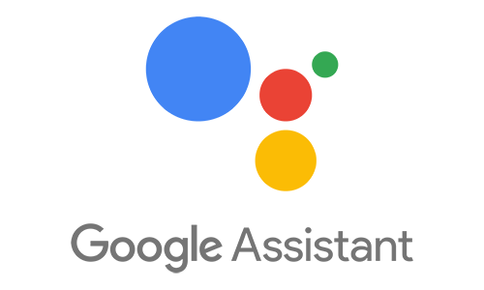

Google assistant
Google Assistant is an artificial intelligence-powered virtual assistant developed by Google that is primarily available on mobile and smart home devices.
Fig: Windows Operating System
Arduino IDE
The Arduino IDE is incredibly minimalistic, yet it provides a near-complete environment for most Arduino-based projects.
We used this platform for coding.
Fig: Aurduino IDE

Slide 10

Adafruit IO
Adafruit.io is a cloud service that just means we can run it without managing by ourselves. We can connect to it over the Internet. It's meant primarily for storing and then retrieving data but it can do a lot more than just that. Adafruit.io can handle and visualize multiple feeds of data.
Fig: Adafruit IO

Slide 11
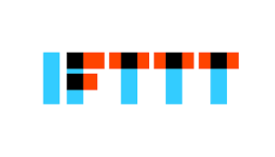
IFTT
If This Then That, also known as IFTTT is a free web-based service to create chains of simple conditional statements, called applets. An applet is triggered by changes that occur within other web services such as Gmail, Facebook, Telegram, Instagram, or Pinterest.
Fig: IFTT

Slide 12

Blynk
Blynk is a platform that allows us to quickly build interfaces for controlling and monitoring hardware projects from Android device.
After downloading the Blynk app, we were create a project dashboard and arrange buttons, sliders, graphs, and other widgets onto the screen.
Fig: Blynk

Slide 13

Overview
We have proposed a system which has the ability to remotely access the home appliances. Many system we saw that have been used internet, wireless technology to communicate and control home appliances, others used Bluetooth and GSM technology for controlling the home appliances.
The main objective of our project was to build a perfect companion for someone to be at home and the system is integrated with three different technology. Generally, home automation research targeted many needs like applications that provide the luxury and smart requirements while some threw light on the special needs for elderly and disabled etc.
We propose a smart home automation system that uses more than one method.

Slide 14
Thank You

